Slide 1
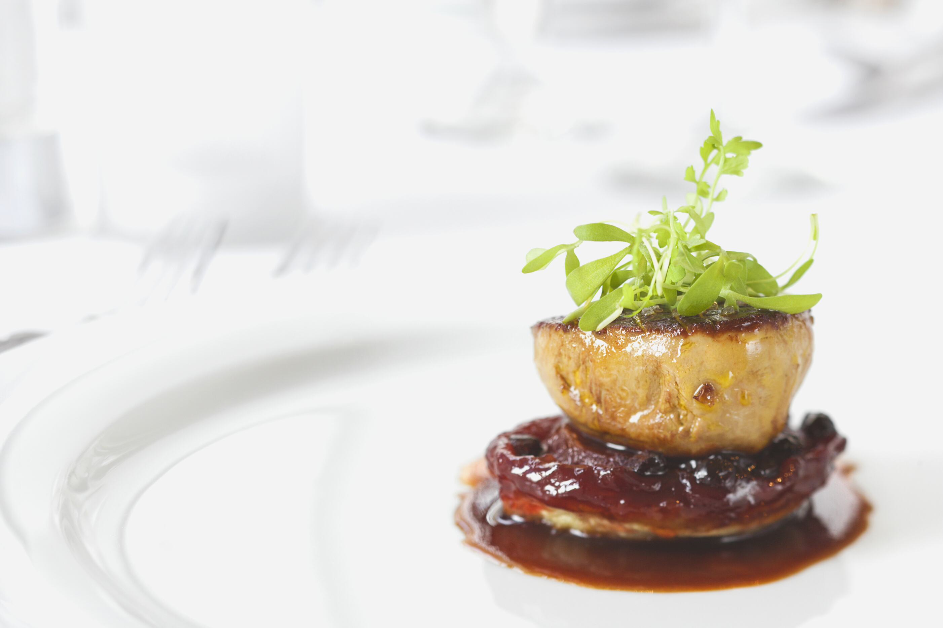
PRESENTATION OF PROJECT ON
FOOD ORDER &
DELVERY SYSTEM

Slide 2
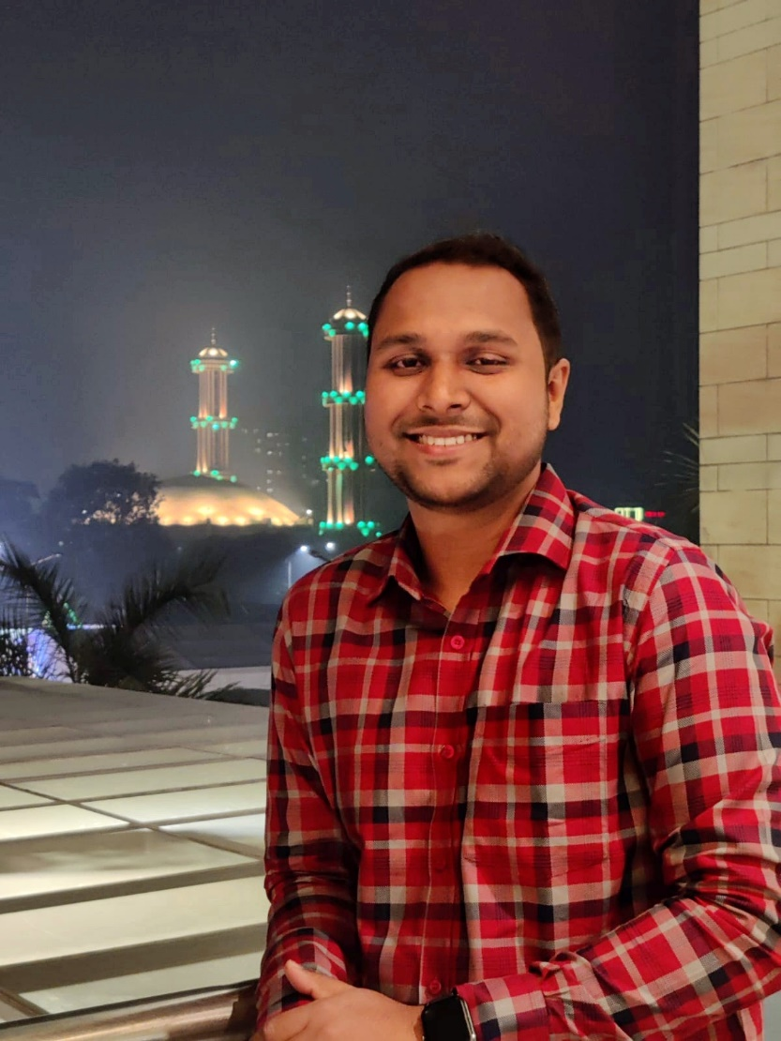
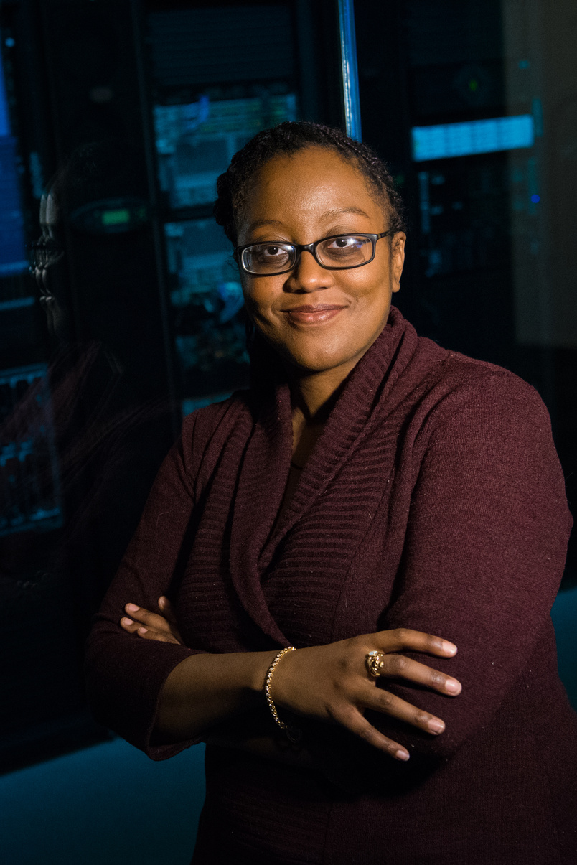
Project Planned, Designed& Processed
By
MD. Zubayer
Department of BTM,
Islamic University of Technology

Slide 3
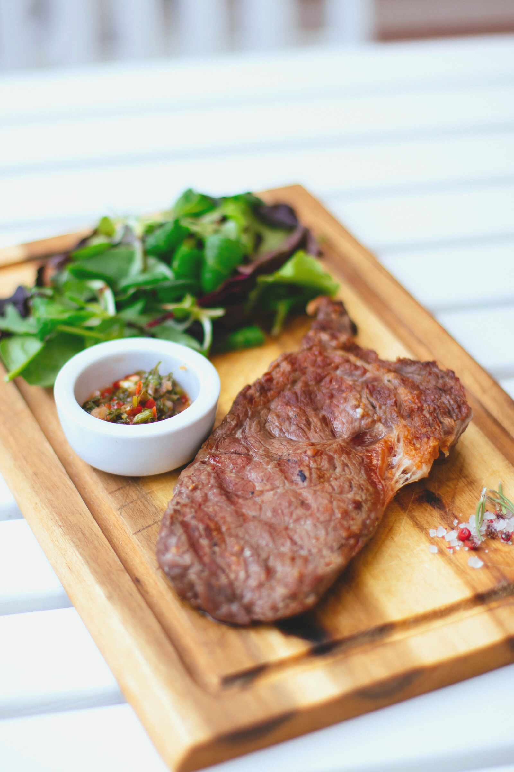
TODAY'S OUTLINE
Table of Contents
Project Proposal
Project Design & Features
Objectivity
Project Implementation
Input & Output
Limitations & Difficulties
Future Development
Individual Contributions

Slide 4
The name of the project is “Food Delivery Service”. It is done by using C++. Main users of this project is-
1. Restaurant Owners
2. Customers
This system enabled the end users to register to the online system. They have the options to select food items from different restaurants and order them. While placing the orders they can select the payment options and receive promotional offers and discounts.
ABOUT
THE PROJECT
A BRIEF BACKGROUND

Slide 5
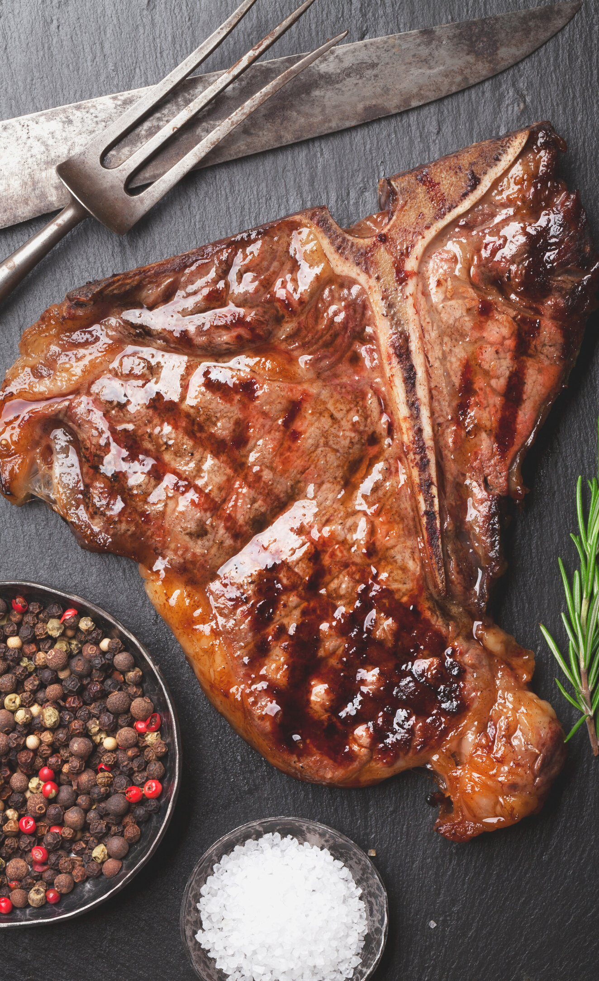
WHY THIS PROJECT?
Our project greatly simplifies the ordering process for both the customers and the restaurants. It presents an up-to-date menu from various restaurants. Customers can order food in a second by clicking on the food items.
“Simplifying Food Ordering Process ”
PROJECT
PROPOSAL

Slide 6
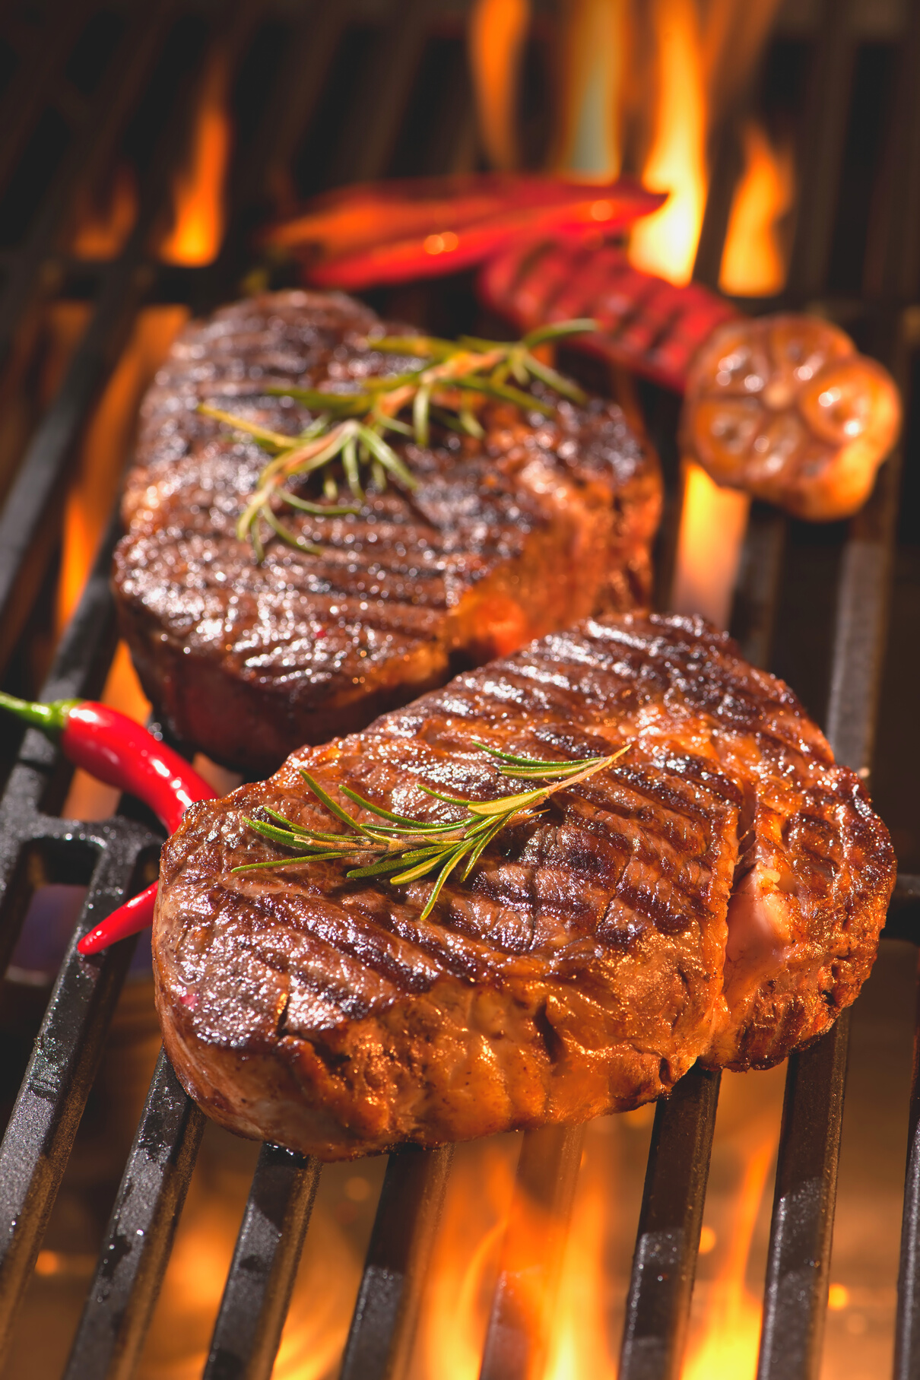

PROJCT DESIGN
Interface
Login/Signup
Login
Main Code
Signup
Database
Final Details

Slide 7
MAIN SYSTEMS
Ordering foods
Delivery
RESTAURANT OWNERS
PROJECT
FEATURES
Access to their own restaurant
Accepting or Rejecting orders
Account privacy
CUSTOMERS
Ordering from a single restaurant item at a time
Fair Transactions
Account privacy
Array of choices

Slide 8

Object Oriented Programing Concepts Used in The Project
Class and Object
Inheritance
Encapsulation
User Defined Functions
PROJECT
IMPLEMENTATION

Slide 9



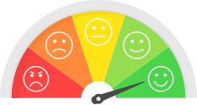
OBJECTIVES & OUTCOMES
The developed project will help the customers to order food in a very convenient way. It will also help the restaurants to perform successful delivery of food to the customers.
Minimizing number of employees in the restaurants
Reducing labor cost
Reducing the rate of mistakes since it’s a machine Increased speed of work.
Cost effectiveness and time efficiency
Customers satisfaction through delivering foods in destination.
Automation and maximum level of overall efficiency

Slide 10




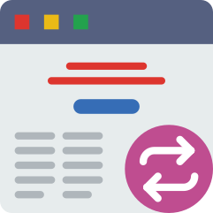

Limitations & Difficulties
This project is implemented in a simple but effective way. As there were some limitations, we tried to keep the code simple. Because of these limitations we couldn’t implement the project like we wanted to.
Lack of Synchronization between the interfaces
Difficulties in using file systems
Lack of advanced knowledge
Absence of Graphical User Interface
Absence of Database/Server

Slide 11
CAN BE IMPLEMENTED IN SMALL AREAS
EASY TO DEVELOP
If needed, the project can be easily developed for commercial use.
In future, this system can be implemented in small areas like some portion of a city or small towns primarily.
Future Developments
ATTRACT INVESTORS
IMPLEMENTATION OF GUI
As this project looks lucrative, it will attract potential investors.
A graphical user interface can be implemented for the project.

Slide 12
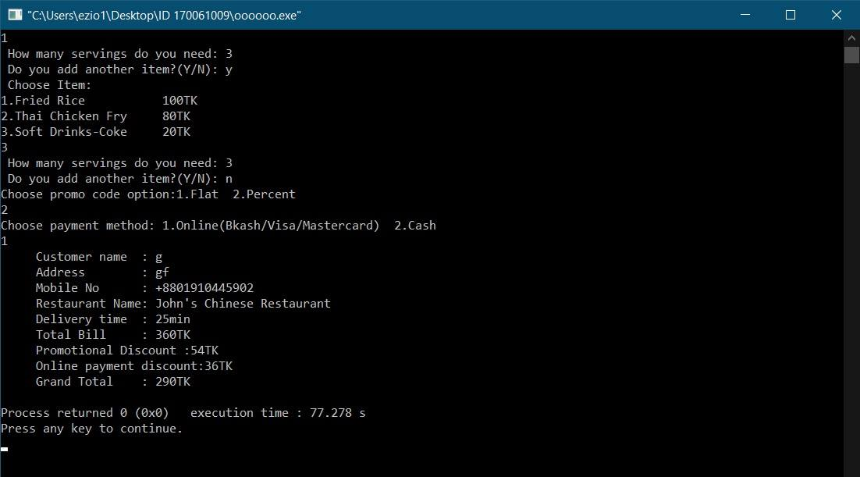
Sample Input and Output

Slide 13
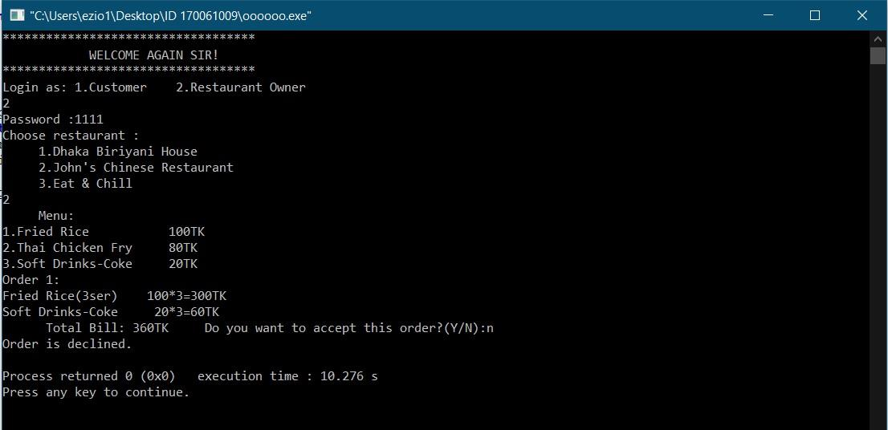
Restaurant Owner Segment

Slide 14
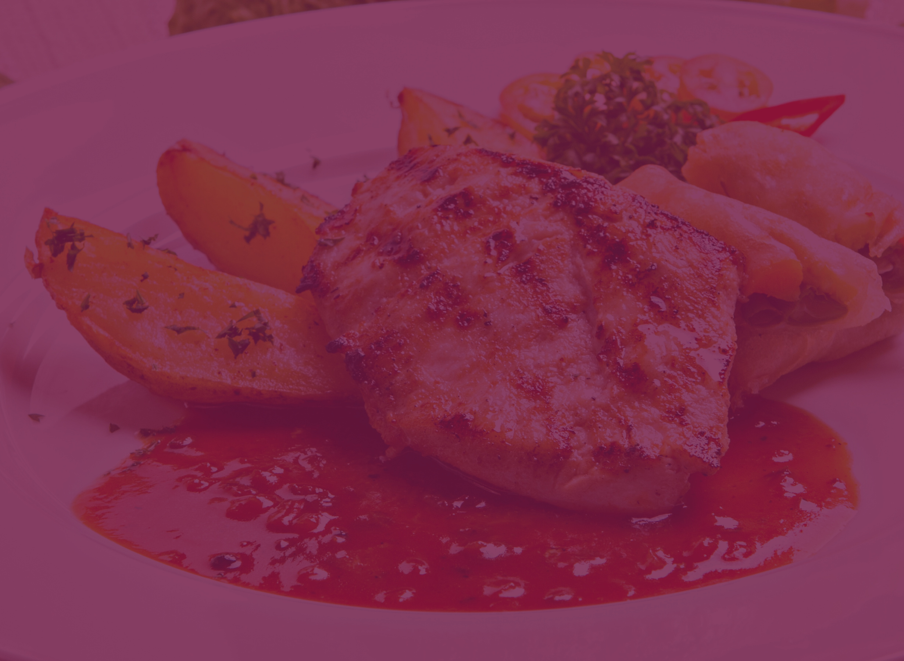

THANK YOU!
.

